Slide 1

Section 2.1 Functions
Lecture 1
Idea of Function
Notation

Slide 2
Section 2.1 Homework Submission to Canvas
Preview of section
Skim the section in text and write a short paragraph summary.
Give a bulleted list of all important definitions, theorems, and formulas without details.
Notes on video lectures
Take notes on everything written on slides including all details, worked examples, on-own activities, as well as your own thoughts and questions.
Try on-own activities first, then write down provided solution next to it for comparison.
Worked examples from the text
Write down the problem and attempt without looking at the solution.
Use the solution to write the best explanation you can.
Solutions to textbook exercises
Model approaches and explanations given in the video lectures and textbook examples.
Final reflection of section
List the key takeaways to remember as a bulleted list.

Slide 3
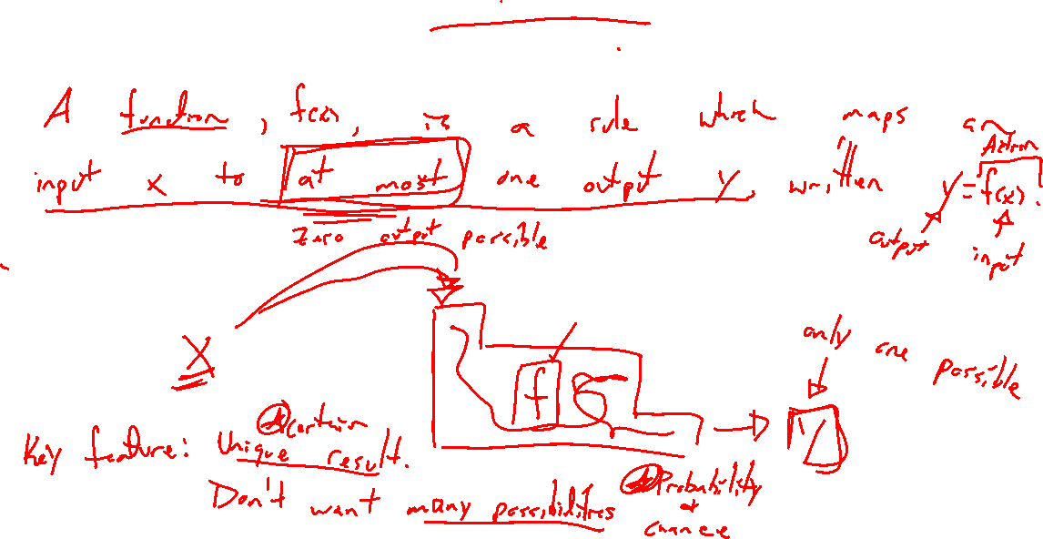
Idea of Function: Try on Own
Notes:
Complete this sentence: A function f is....
- What is the key idea? Why does it matter? Go as detailed as possible.
A function f is a rule which maps one input x to at most one output y, written y=f(x).
Machine: One thing in, at most one out.
Example: Email mapped to student

Slide 4
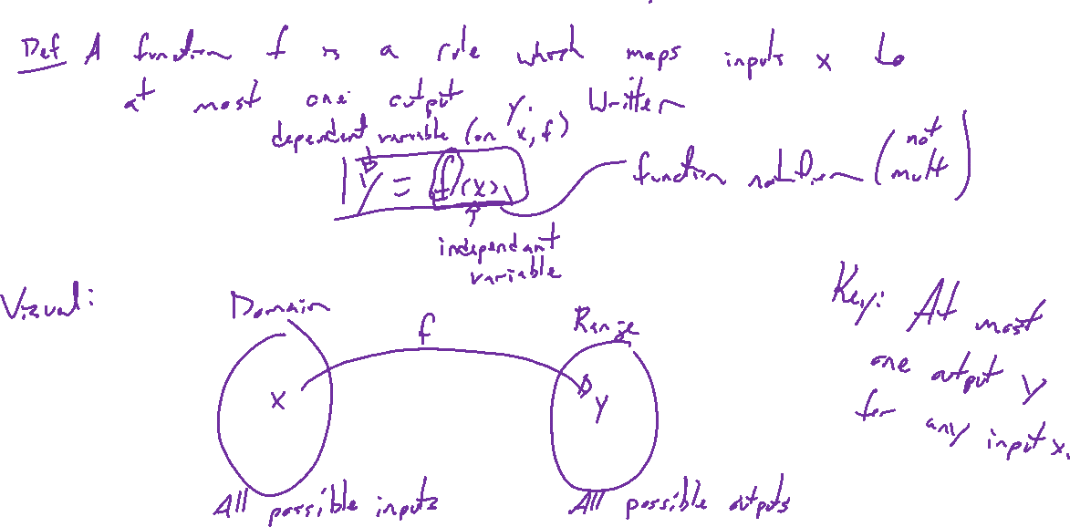
Function Definitions
Notes:
Formal definitions:
A function f is a rule which maps one input x to at most one output y, written y=f(x).
Diagram to conceptualize: Domain, range, indep variable, dep variable
Most important part: One input to at most one output. Why? Want certainty in what will happen.

Slide 5
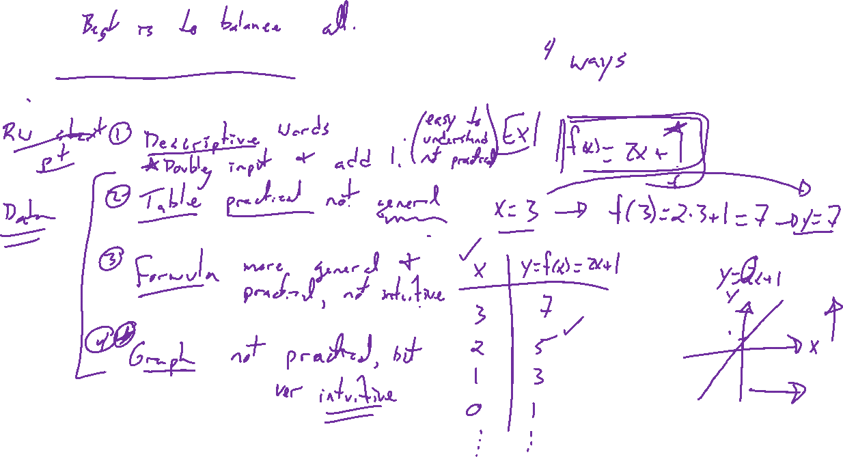
Representations of Functions
Notes:
Description (easy to understand, hard to use)
Table (practical, not general)
Formula (good for calculation, not intuitve)
Graph (good for intuition, not practical)
Ex: Line y = 2x+1. 4 versions.

Slide 6
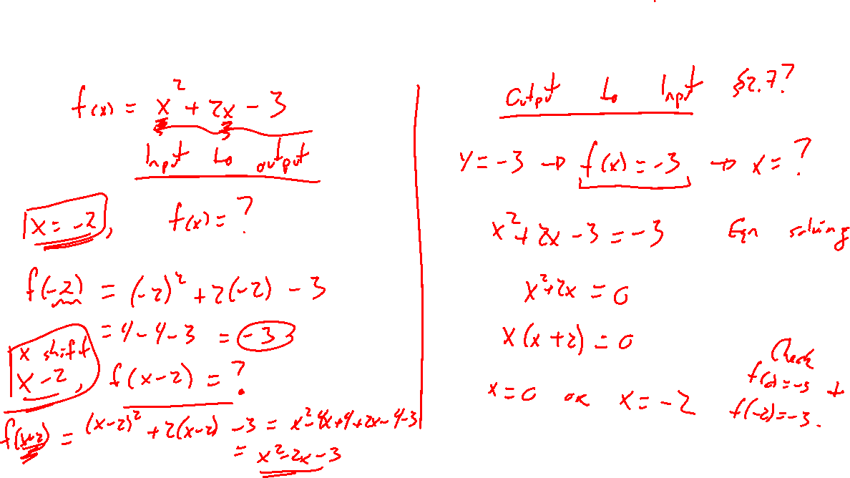
Example: Function as a formula
Notes:
Consider y=f(x), y as a function of x, where f(x)=x^2+2x-3
Input to output
F(2)=?, f(x+2)=?,

Slide 7
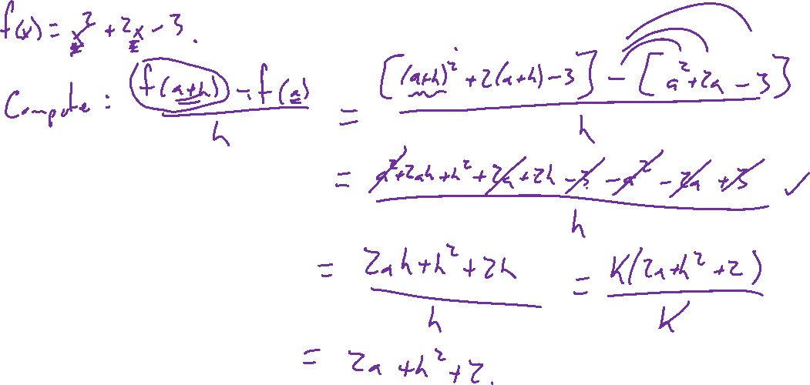
Example: Try on Own
Notes:
Consider y=f(x), y as a function of x, where f(x)=x^2+2x-3
Difference quotient (f(a+h)-f(a))/h

